Slide 1

Industrial/Organizational Psychology: An Applied Approach, 9e
Chapter 11: Organizational Communication
Michael G. Aamodt, Industrial/Organizational Psychology: An Applied Approach, 9th Edition. © 2023 Cengage. All Rights Reserved. May not be scanned, copied or duplicated, or posted to a publicly accessible website, in whole or in part.

Slide 2
Icebreaker
Break into pairs of students.
With your partner, list as many methods as possible for an organization to recruit potential employees (e.g., social media ads).
Present your listed methods to the class.

Slide 3
Learning Objectives
11-01 Recognize the types of organizational communication
11-02 Explain why interpersonal communication often is not effective
11-03 Increase your listening effectiveness
11-04 Improve your communication skills

Slide 4
Activity: Discussion
Think of a situation in which you and another person did not communicate effectively. Describe what happened. Why do you think the miscommunication took place?

Slide 5
Types of Organizational Communication

Slide 6
The Forms of Organizational Communication
Upward
Downward
Business
Informal
Interpersonal

Slide 7
Organizational Communication: Upward Communication
Serial communication
MUM effect
Attitude surveys
Focus groups
Exit interviews
Suggestion boxes
Third party facilitators
Liaison
Ombudsperson

Slide 8
Organizational Communication: Downward Communication
Bulletin boards
Policy manuals
Newsletters
Intranets

Slide 9
Organizational Communication: Business Communication
Telephone calls
Videoconferencing
Email
Voice mail
Business meetings

Slide 10
Email Etiquette
Include a greeting
Include a detailed subject line
Don’t write in all caps
Delete unnecessary information when forwarding email
Avoid grammar and spelling mistakes
Don’t spend company time on personal email
Allow ample time for a person to respond

Slide 11
Voice Mail Etiquette
Speak slowly
Give your name at the beginning of the message and then repeat it at the end
Spell your name
Leave your phone number
Indicate good times for the person to return your call
Don’t ramble
Don’t include information you don’t want others to hear

Slide 12
Videoconferencing Etiquette
Wear appropriate clothing for your audience
Start the call on time and end early
Be aware of your background
Mute yourself when not speaking
Do not multitask during the meeting
Be careful about your nonverbal communications

Slide 13
Office Design
Designs
Open (landscaped) offices
Bullpen design
Uniform design
Free-form workstations
Boulevards
Portable offices
Research on open designs
Decreased satisfaction
Increased socialization
Decreased costs

Slide 14
Organizational Communication: Informal Communication
Grapevine
Single-strand grapevine
Gossip grapevine
Probability grapevine
Cluster grapevine
Isolates
Dead-enders
Gossip
Rumor

Slide 15
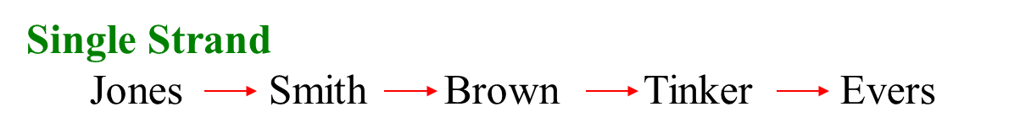
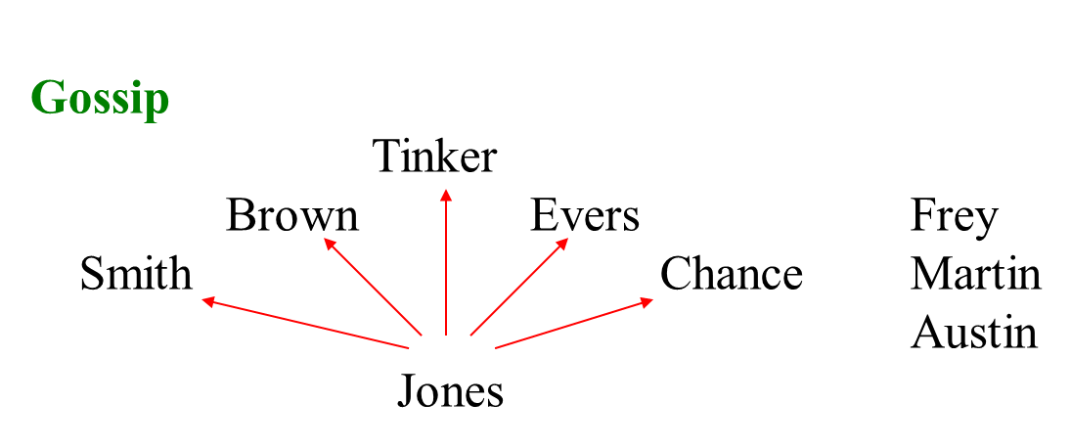
Grapevine Patterns: Single Strand and Gossip

Slide 16
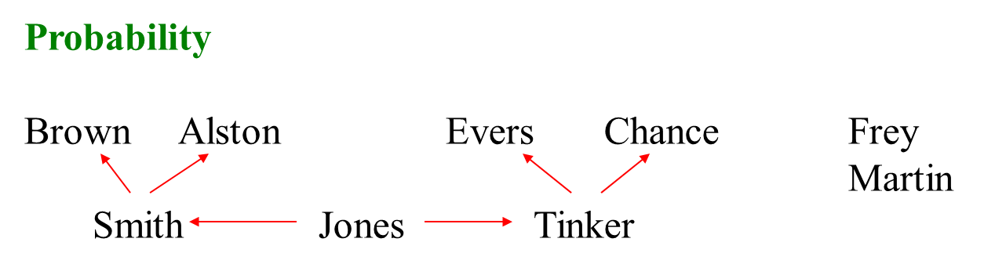
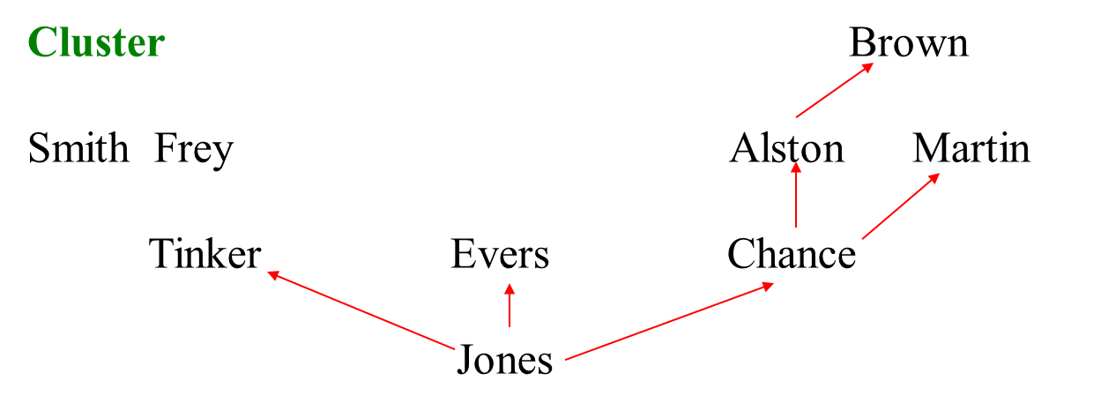
Grapevine Patterns: Probability and Cluster

Slide 17
Workbook Exercise 11.2 Informal Communication

Slide 18
Interpersonal Communication

Slide 19
Interpersonal Communication Problems
The exchange of a message across a communication channel from one person to another
Three problem areas
Intended message versus message sent
Message sent versus message received
Message received versus message interpreted

Slide 20
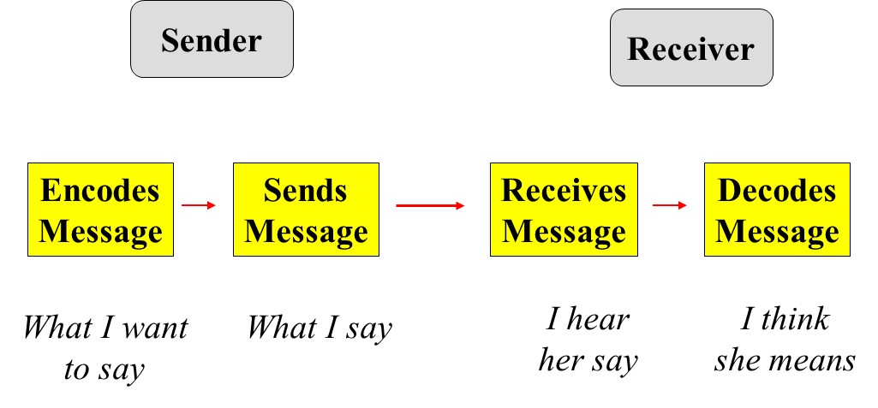
The Interpersonal Communication Process

Slide 21
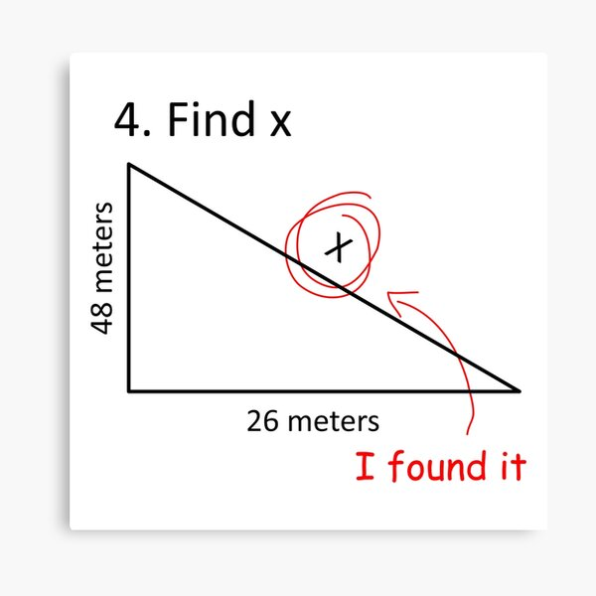

Slide 22
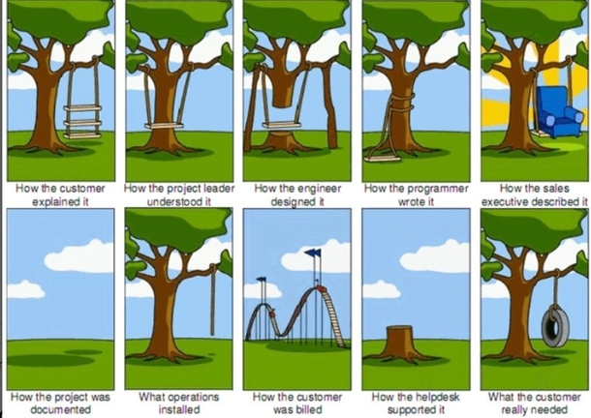

Slide 23
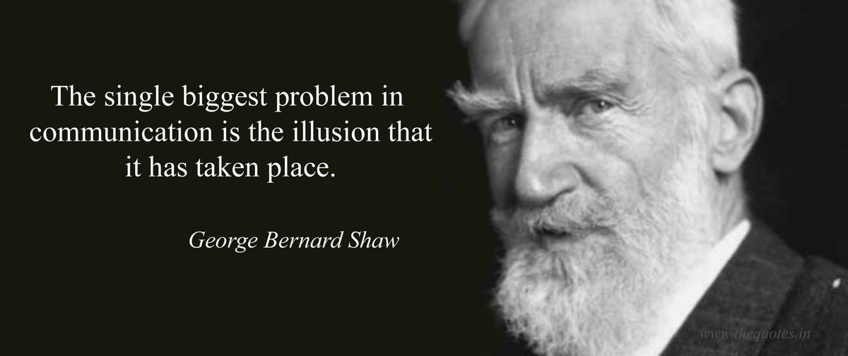

Slide 24
Problem Area I: Intended Message Versus Message Sent
Think about what you want to communicate
Practice what you want to communicate
Learn better communication skills

Slide 25
Problem Area II: Message Sent Versus Message Received
Actual words used
Communication channel
Noise
Nonverbal cues
Body language
Use of space
Use of time
Paralanguage
Artifacts
Amount of information

Slide 26
Actual Words Used
The word “fine”:
to describe jewelry
to describe the weather
to describe food
The applicant was a:
woman
girl

Slide 27
Use Concrete Words and Ask How the Other Person Might Interpret Your Message
Avoid such words as:
as soon as possible
I’ll be back soon
I’ll be out for a while
Why not be specific?
Avoid confrontation
“Test the water”
Avoid being the bad person (MUM effect)

Slide 28
Gender Differences in Communication (Tannen, 1995, 2001)
Men
Talk about major events
Tell the main point
Are more direct
Use “uh-huh” to agree
Are comfortable with silence
Concentrate on the words spoken
Sidetrack unpleasant topics
Women
Talk about daily life
Provide details
Are more indirect
Use “uh-huh” to listen
Are less comfortable with silence
Concentrate on nonverbal cues and paralanguage
Focus on unpleasant topics

Slide 29
Communication Channels
Oral
In-person
Word-of-mouth
Answering machine
Nonverbal
Written
Personal letter/memo
General letter/memo
Email

Slide 30
Noise
Actual noise
Appropriateness of the channel
Bias
Feelings about the person communicating
Mood
Perceived motives

Slide 31
Nonverbal Cues
Are ambiguous
Those that aren’t, are called emblems
Gender and cultural differences are common
Nonverbal cues are thought to be a high percentage of the message received

Slide 32
Body Language
How one’s body faces another person
Interrupting others, leaning back in a chair
Eye contact
Raising or lowering head or shoulders
Touching someone
Fidget, raise their chin when lying (DePaulo et al., 2003)

Slide 33
Workbook Exercise 11.3 Nonverbal Cues

Slide 34
Use of Space
Intimacy zone
0 to 18 inches
Close relationships
Personal distance zone
18 inches to 4 feet
Friends and acquaintances
Social distance zone
4 to 12 feet
Business contacts and strangers
Public distance zone
12 to 25 feet

Slide 35
Use of Time
Being late
Leaving a meeting early
Setting aside time for a meeting
Multitasking (working while talking)

Slide 36
Basic Assumptions About Nonverbal Cues & Paralanguage
People are different in their use of nonverbal cues and paralanguage
Standard differences among people reveal information about the person
Changes in a person’s style reveal new messages

Slide 37
Paralanguage
Rate of speech
Loudness
Intonation
Amount of talking
Voice pitch
Pauses

Slide 38
The Importance of Inflection
I did not say Bill stole your car.
I did not say Bill store your car.
I did not say Bill stole your car.
I did not say Bill stole your car.
I did not say Bill stole your car.
I did not say Bill stole your car.
I did not say Bill stole your car.

Slide 39
Artifacts
Our office
Décor
Desk placement (open or closed)
What we wear
Clothing
Accessories
Hair styles
Tattoos
The car we drive
The house we live in

Slide 40
The Amount of Information
When we have too much information, we tend to:
Assimilate
Sharpen
Level

Slide 41
Workbook Exercise 11.4 Communication Overload

Slide 42
Reactions to Information Overload
Omission
Error
Queuing
Escape
Use of a gatekeeper
Use of multiple channels

Slide 43
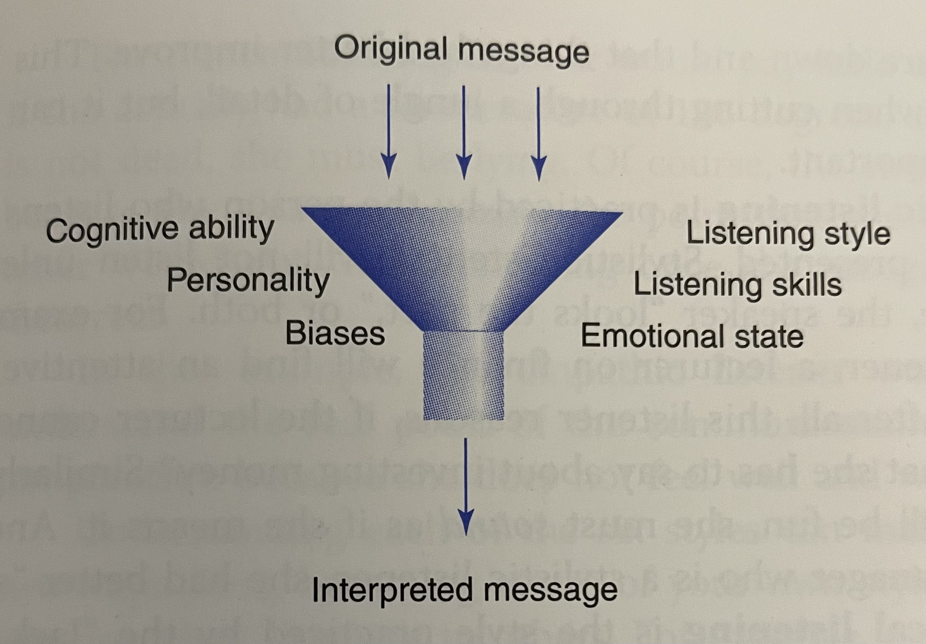
Problem Area III: Message Received Versus Message Interpreted
Listening Skills
Listening Style
Emotional State
Bias

Slide 44
The Importance of Listening
70% of the white-collar workday is spent communicating
Of that time:
9% is spent writing
16% is spent reading
30% is spent speaking
45% is spent listening

Slide 45
Listening Styles (Geier & Downey, 1980)
Leisure
Inclusive
Stylistic
Technical
Empathic
Nonconforming

Slide 46
Listening Skills
Stop talking and listen
Show the speaker you want to listen
Empathize with the speaker
Don’t ask excessive questions
Remove distractions
Keep an open mind
Use appropriate nonverbal cues
Let the other person finish speaking
Try to understand what the other person means

Slide 47
Workbook Exercise 11.5 What is your Listening Style?

Slide 48
Workbook Exercise 11.6 Dealing with Different Listening Styles

Slide 49
Workbook Exercise 11.7 How Good are your Listening Skills?

Slide 50
Other Factors
Emotional State
Anger
Fear
Anxiety
Excitement
Love
Bias

Slide 51
Improving Employee Communication Skills

Slide 52
Employee Communication Skills
Interpersonal communication skills
Written communication skills
Improving writing
Readability
Fry Readability Graph
Flesch Index
FOG Index
Dale-Chall Index

Slide 53
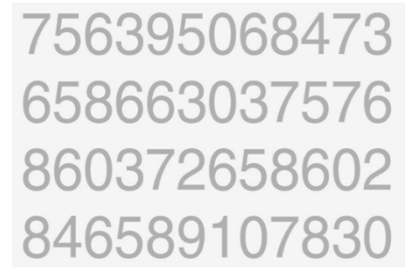
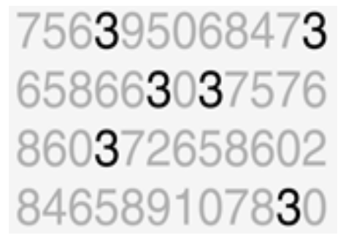
Of course… a little data plug

Slide 54
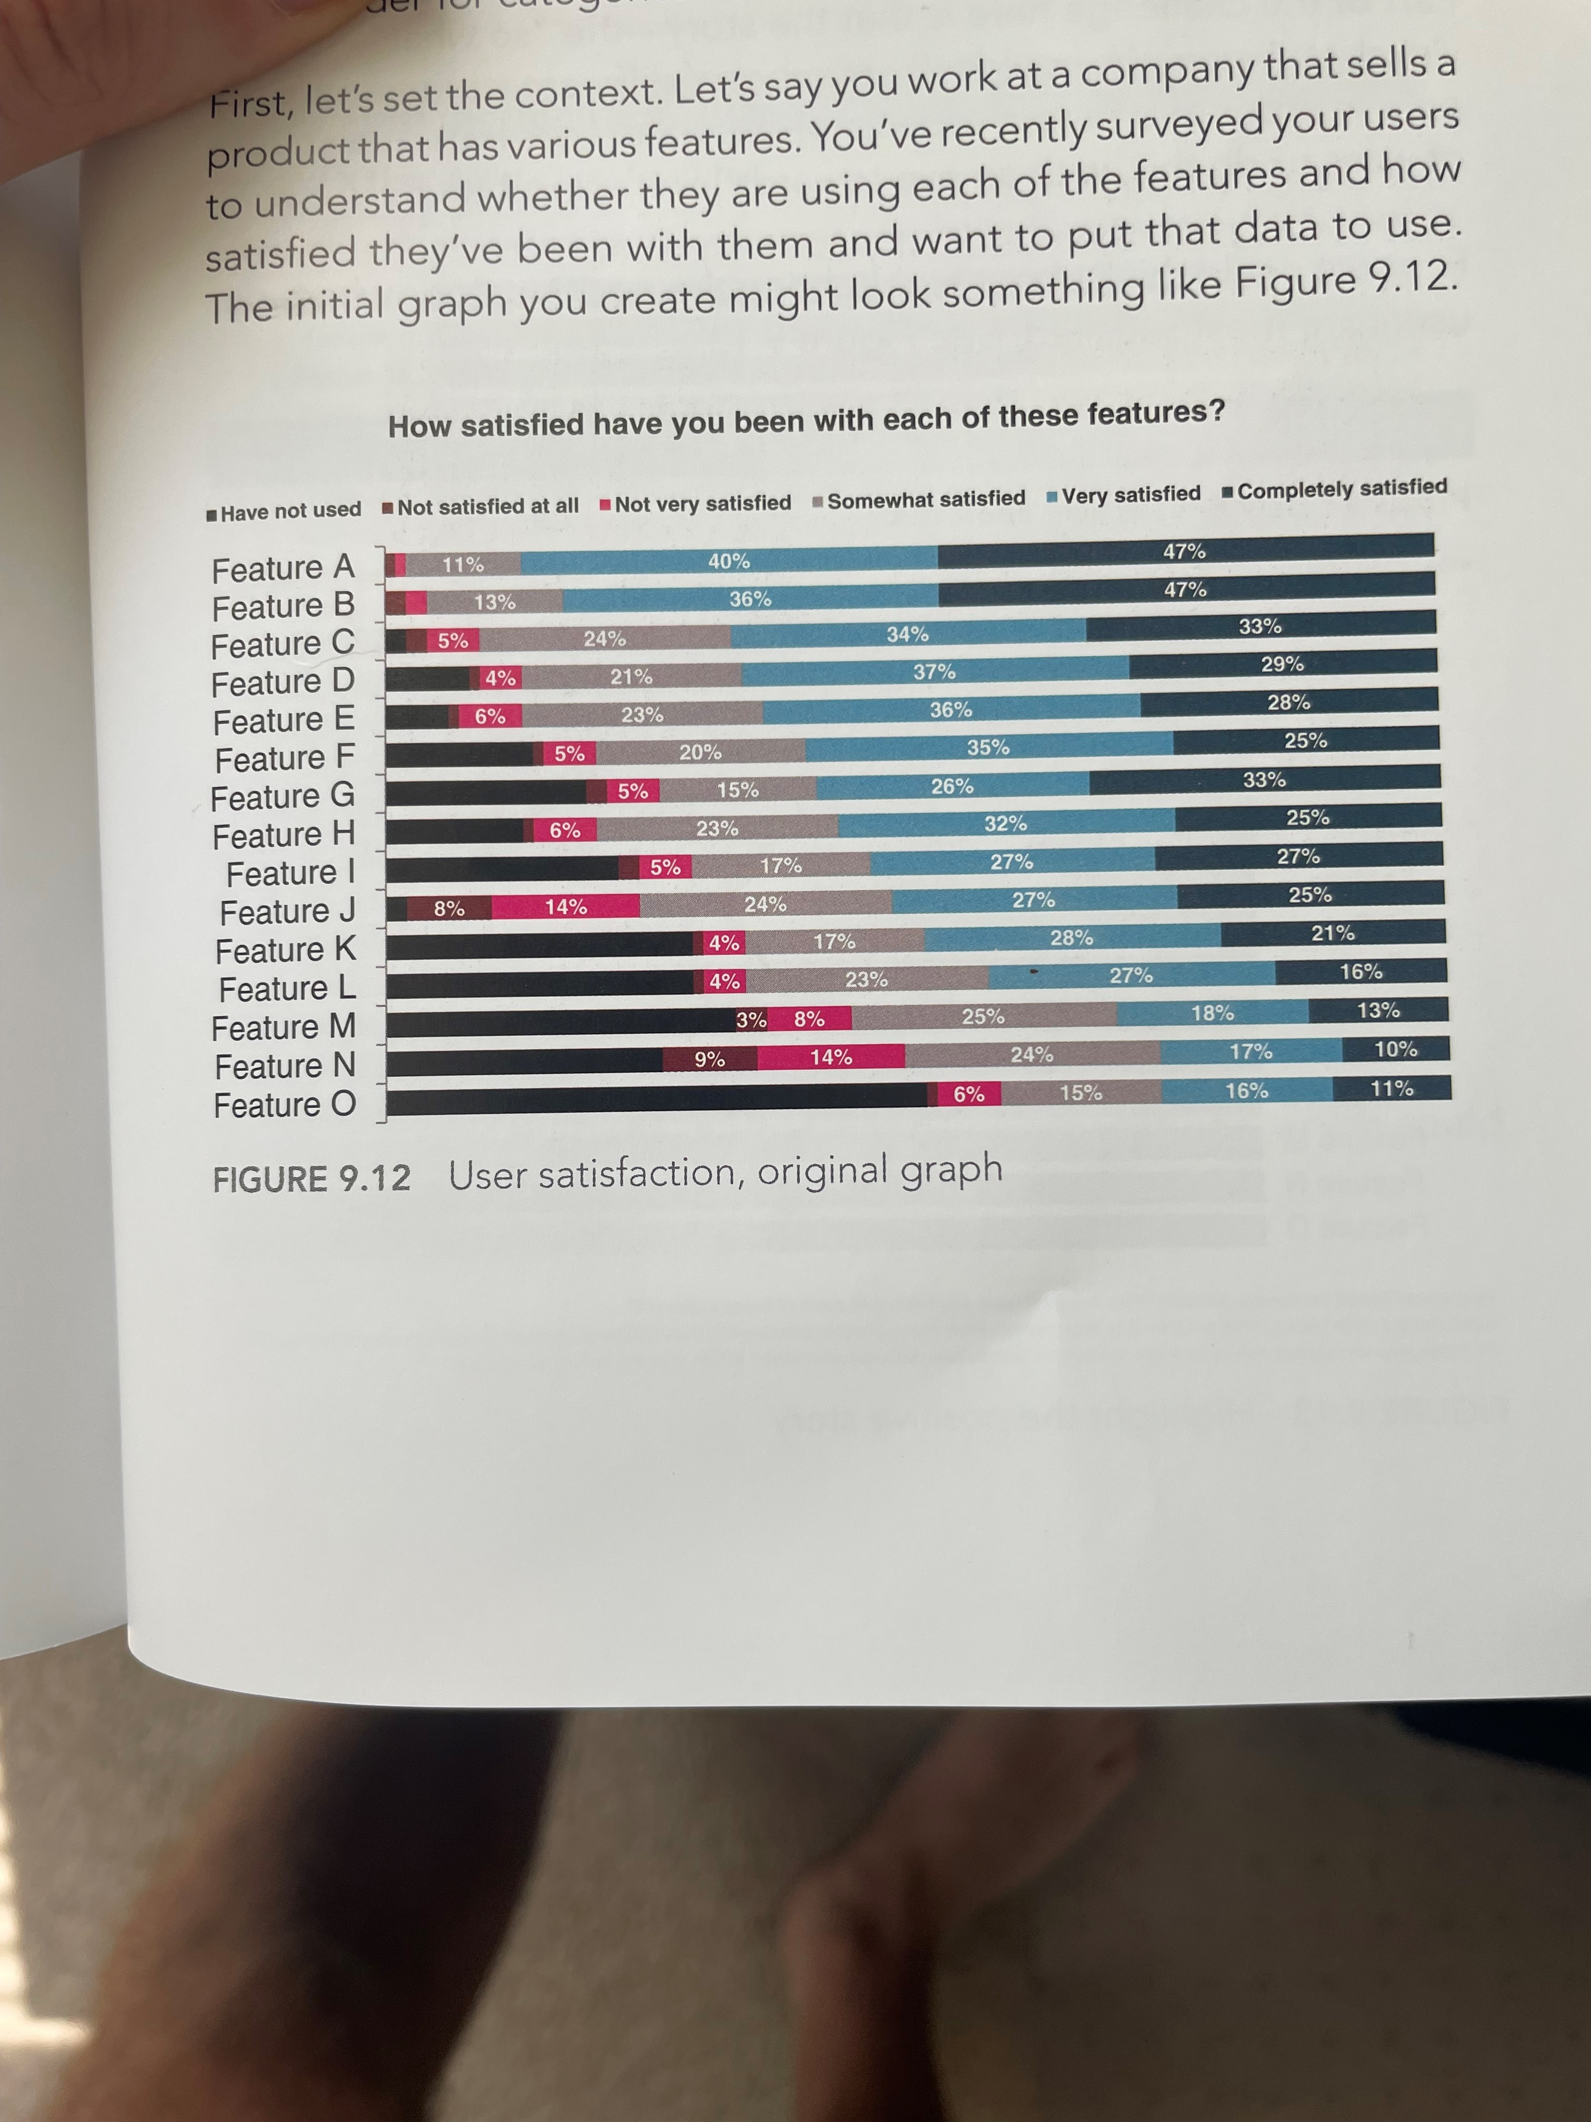
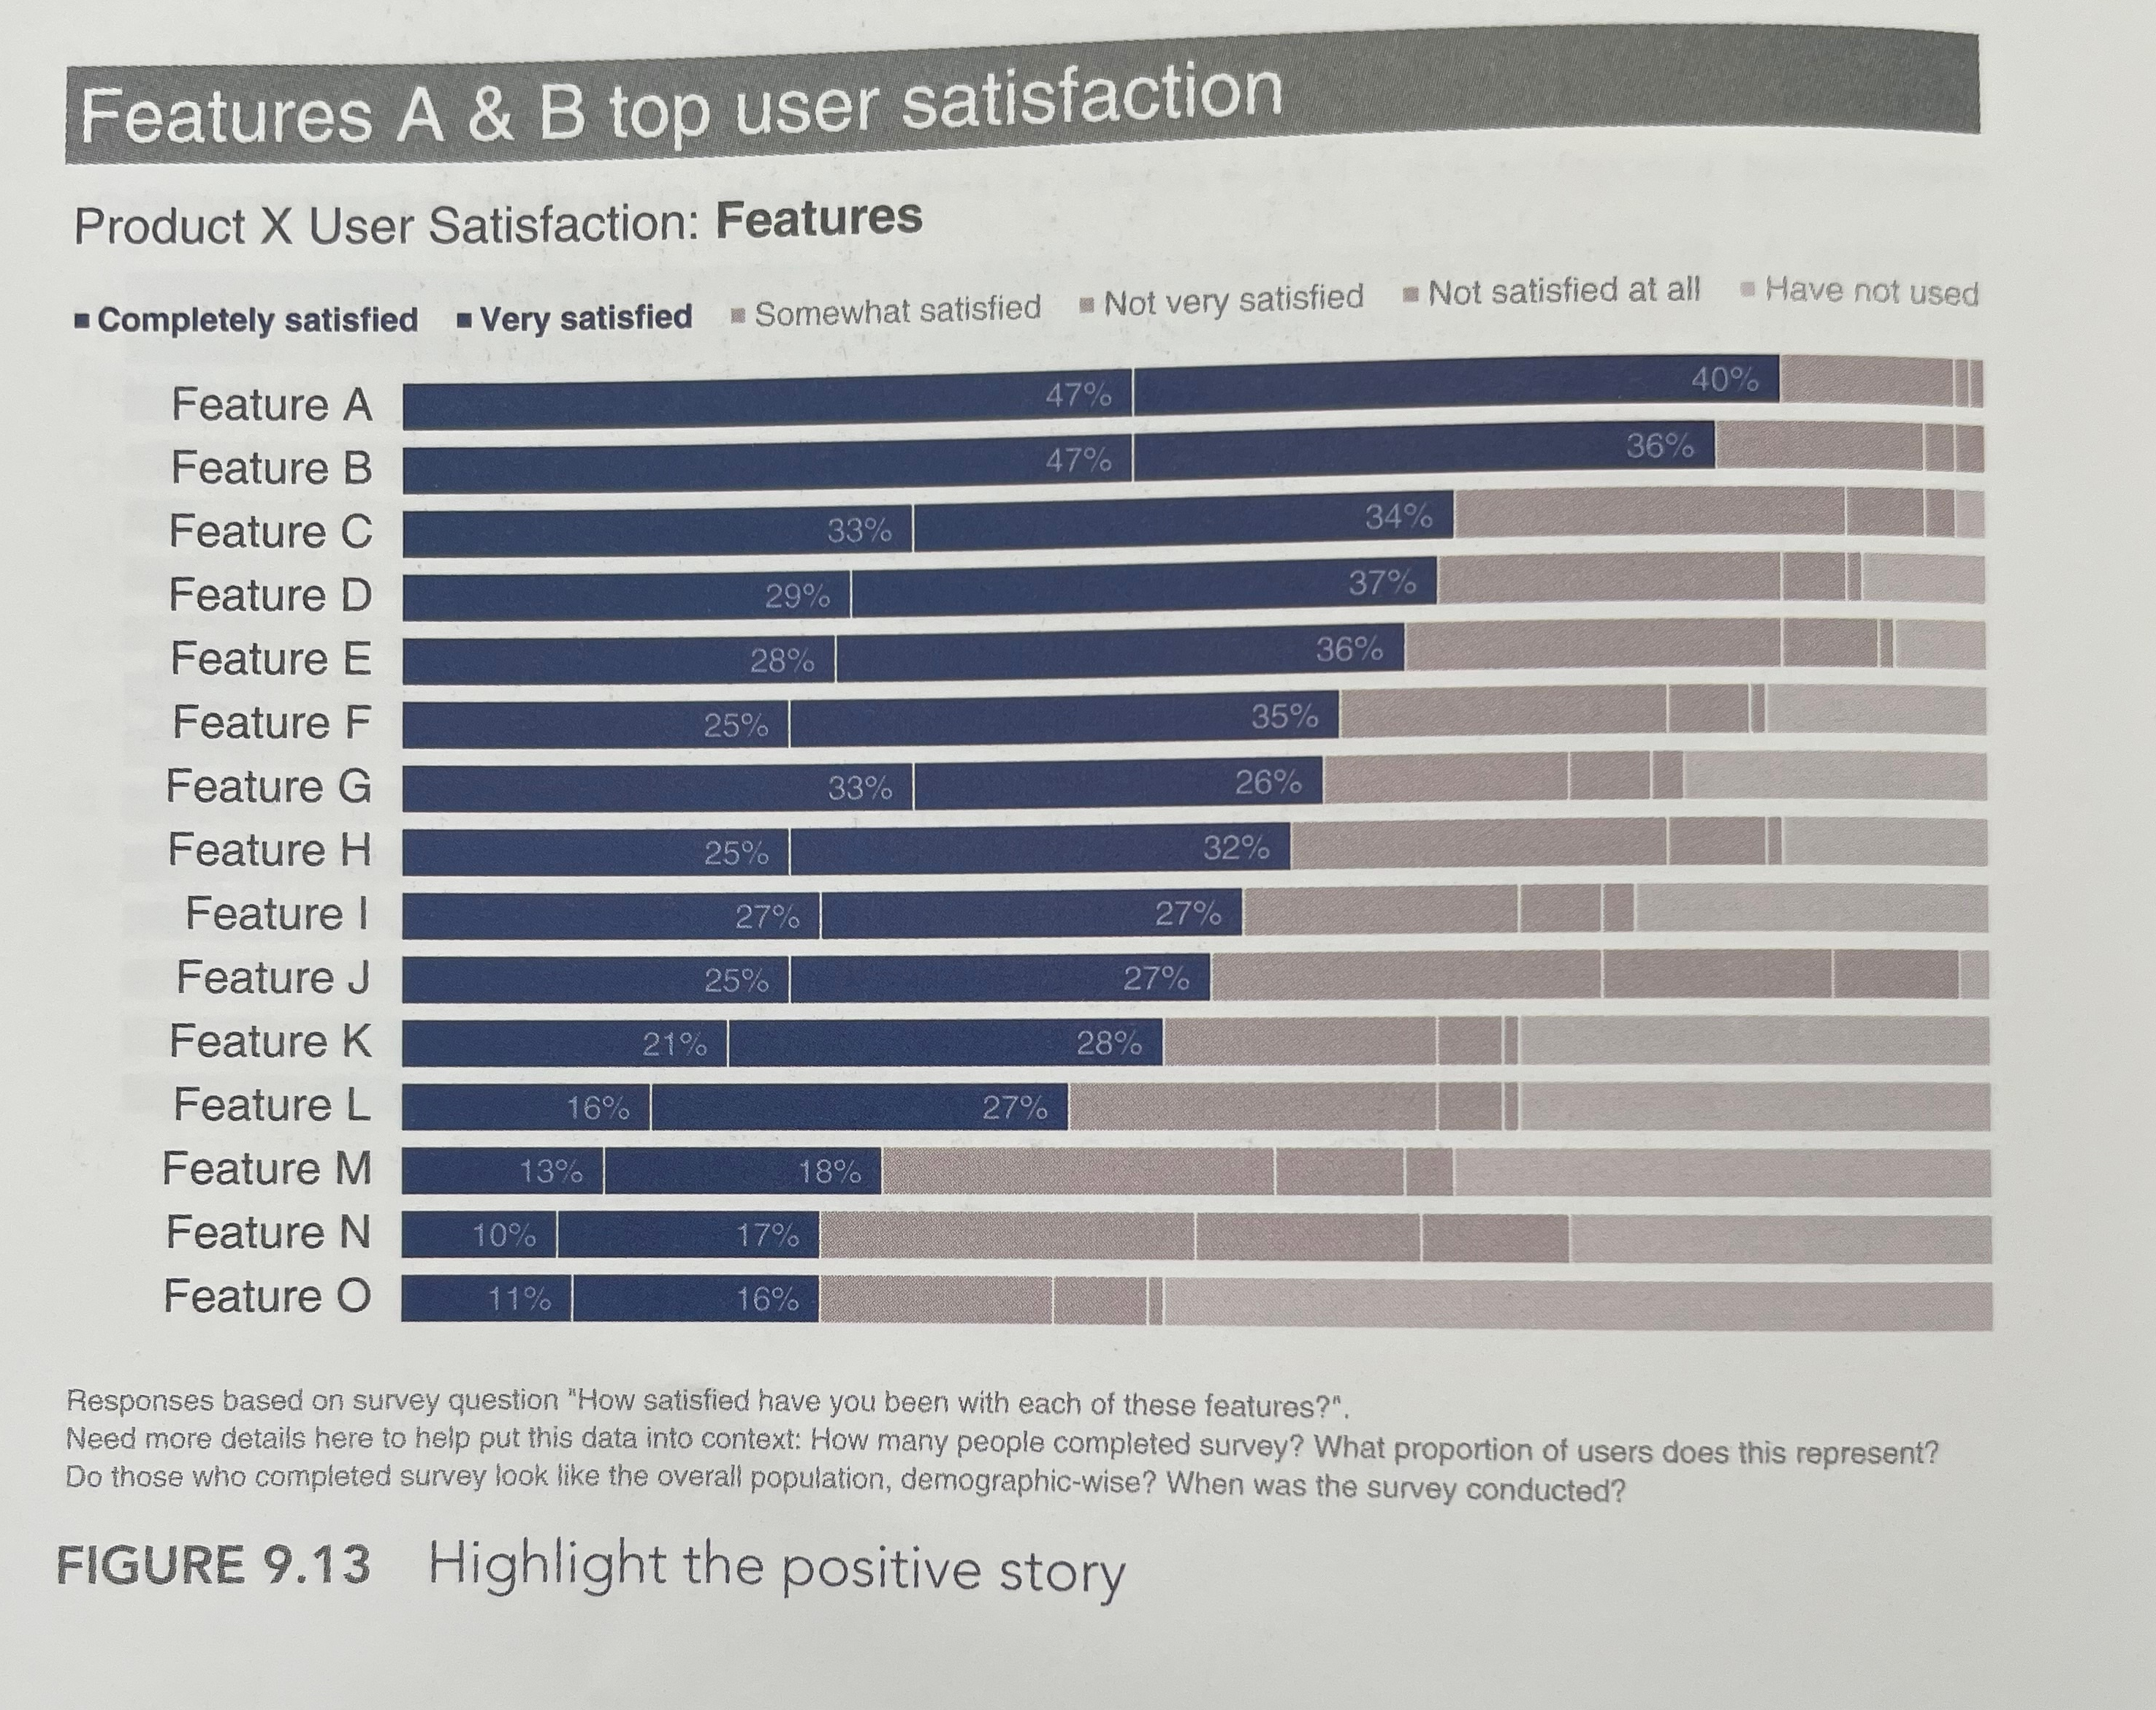
Storytelling with data

Slide 55
Comparison of Readability Scales
Method | Readability Index: Fry | Readability Index: Flesch | Readability Index: FOG | Readability Index: Dale-Chall
Average number of syllables per word | X | X
Average sentence length | X | X
Average number of words per sentence |  |  | X
Average number of 3-syllable words |  |  | X
Number of unusual words |  |  |  | X

Slide 56
Workbook Exercise 11.8 Determining Readability

Slide 57
Answer to Exercise 11.8
Factor | Answer
Number of total words | 124
Number of sentences | 7
Number of syllables | 208
Sentences per 100 words | 5.65 = (7 ÷ 124) * 100
Syllables per 100 words | 167.74 = (208 ÷ 124) * 100
Readability level | 11th or 12th (borderline)

Slide 58
Putting It All Together
Applied Case Study: Reducing Order Errors at Hardee’s and McDonald’s

Slide 59
Let’s Talk
Focus on Ethics: Ethical Communication

Slide 60
Self-Assessment
Why do people hate to communicate bad news?
When is email an inappropriate method of communication?
What is the best way to stop a rumor?
Which is most important: nonverbal cues, paralanguage, or the actual words chosen to communicate? Why?
Can people be taught to be effective listeners? Explain your answer.

Slide 61
What Do You Think?
Would there ever be a time where it would be more ethical to hold back information from employees?
If you were the CEO, what would you consider to be the ethical step to take: inform employees of the possibilities of layoffs or keep that information confidential until the company is absolutely sure layoffs might happen?
Do you think it is unethical not to tell your boss that you are looking for another job? What are the situations in which employees have an ethical obligation to provide this information to their managers or supervisors?

Slide 62
Let’s talk
Project Presentations
~5 minutes per person in group (everyone speaks)
PowerPoint or similar
What job are you doing?
Talk us through the process-what did you do, how did you get here, what learnings to you encounter?
What did you create? Showing the appendix examples are encouraged
https://blog.online.colostate.edu/blog/uncategorized/presentation-tips-for-college-students/

Slide 63
Summary
Now that the lesson has ended, you should have learned how to:
Recognize the types of organizational communication
Explain why interpersonal communication often is not effective
Increase your listening effectiveness
Improve your communication skills
Notes:
Review objectives.

